Slide 1
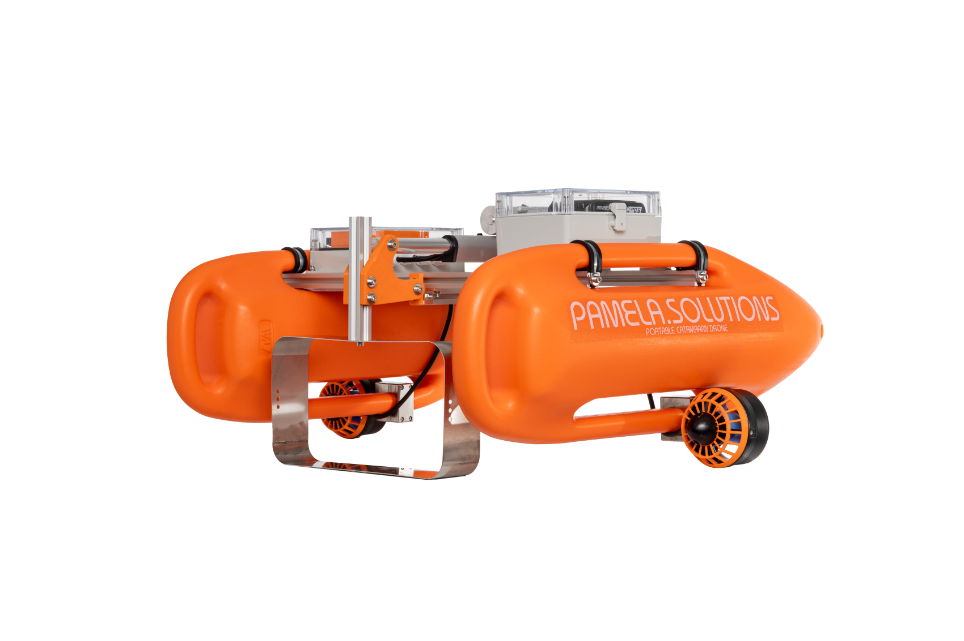
PAMELA
Portable Autonomous Marine
Exploration and Learning Apparatus
Visit: https://pamela.solutions/

Slide 2
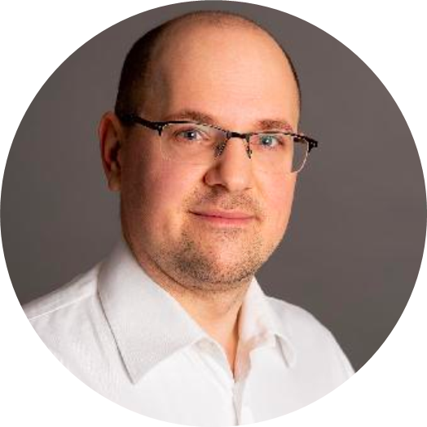
TEAM
Andrea Faltynkova, CEO
Expert in microplastics research
PhD candidate @ NTNU
https://www.linkedin.com/in/a-faltynkova/
Artur Zolich, CTO
Associate Professor in Mechatronics @ OsloMet Oceanlab
https://www.linkedin.com/in/artur-zolich/
Visit: https://pamela.solutions/

Slide 3
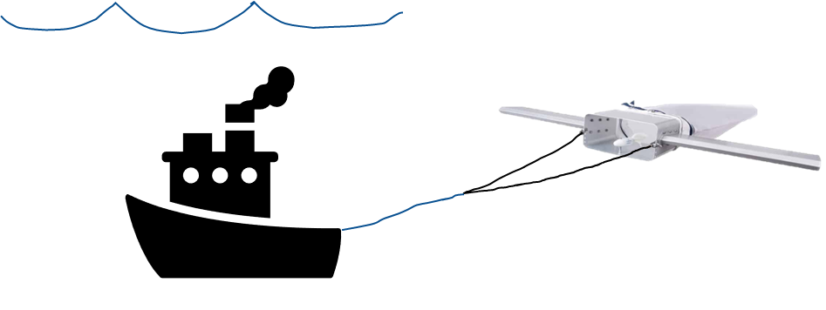

Slide 4
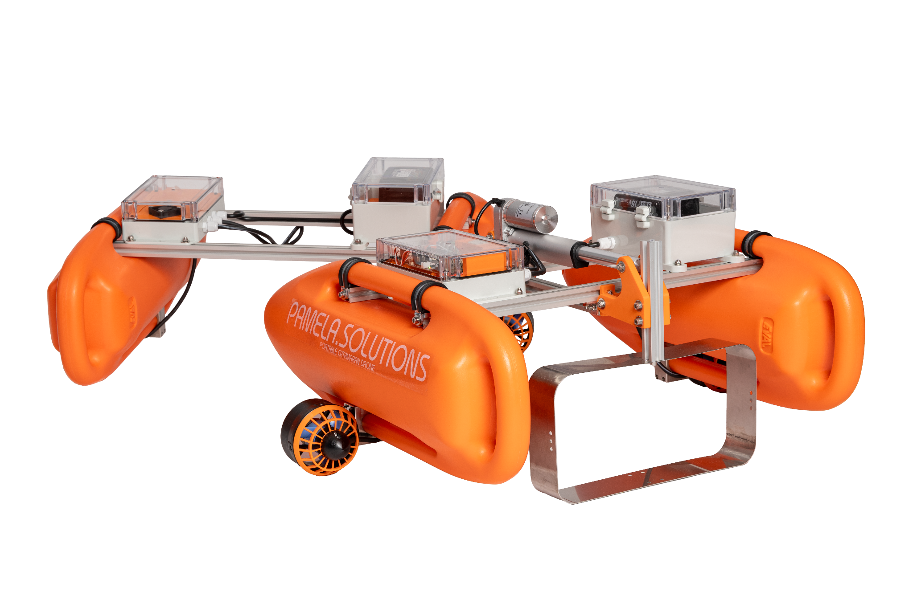
SOLUTION - PAMELA
Visit: https://pamela.solutions/
Notes:
We address the issues of accessibility and scalability for sampling of aquatic environments. We limit the cost per sample and improve sample quality. We offer marine drones - PAMELAs - which turn traditional sampling equipment into standalone devices. The advanced version of the robot is able to navigate automatically, minimizing workload. Multiple robots can be deployed at once, directly from the shore, or from a boat/vessel, simultaneously collecting samples over repeatable paths. In addition we also offer an entry level, remotely controlled model.

Slide 5
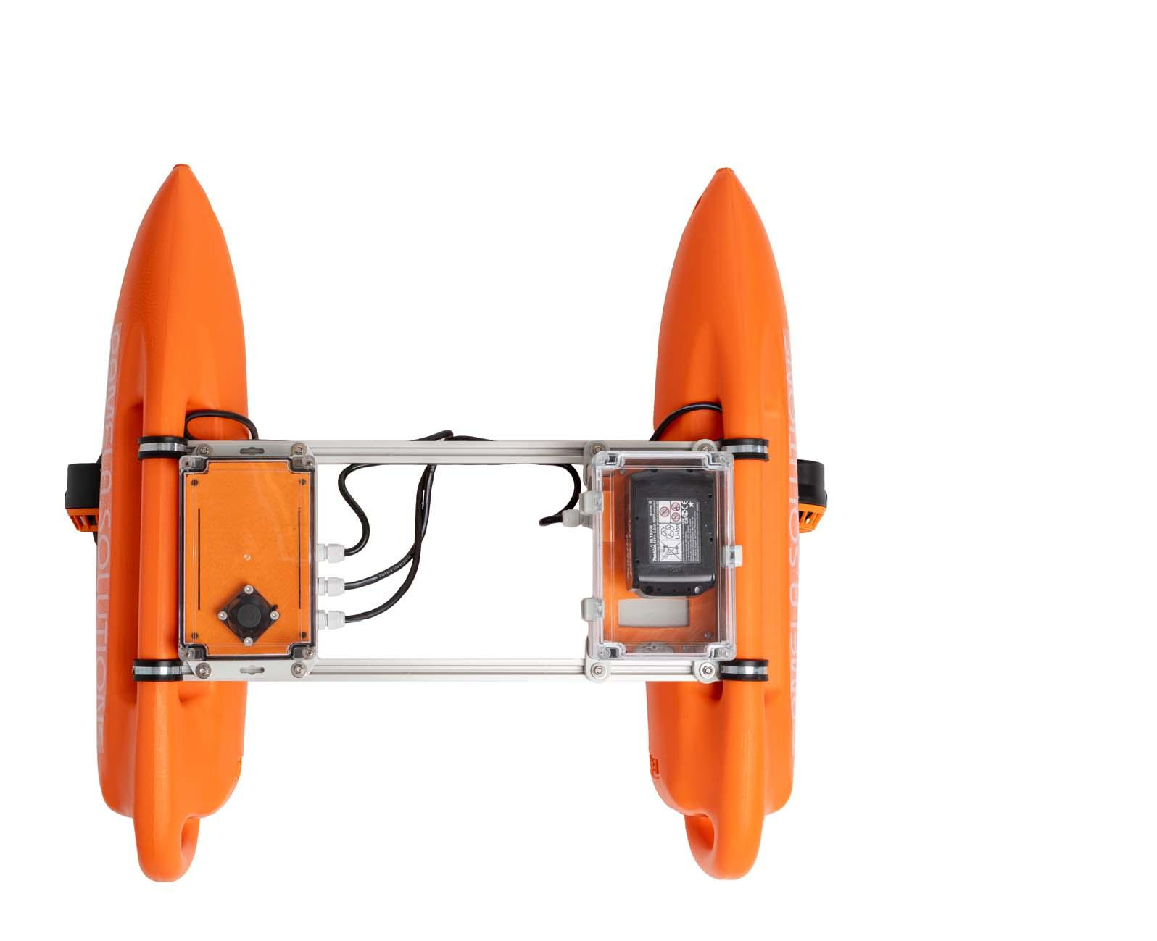
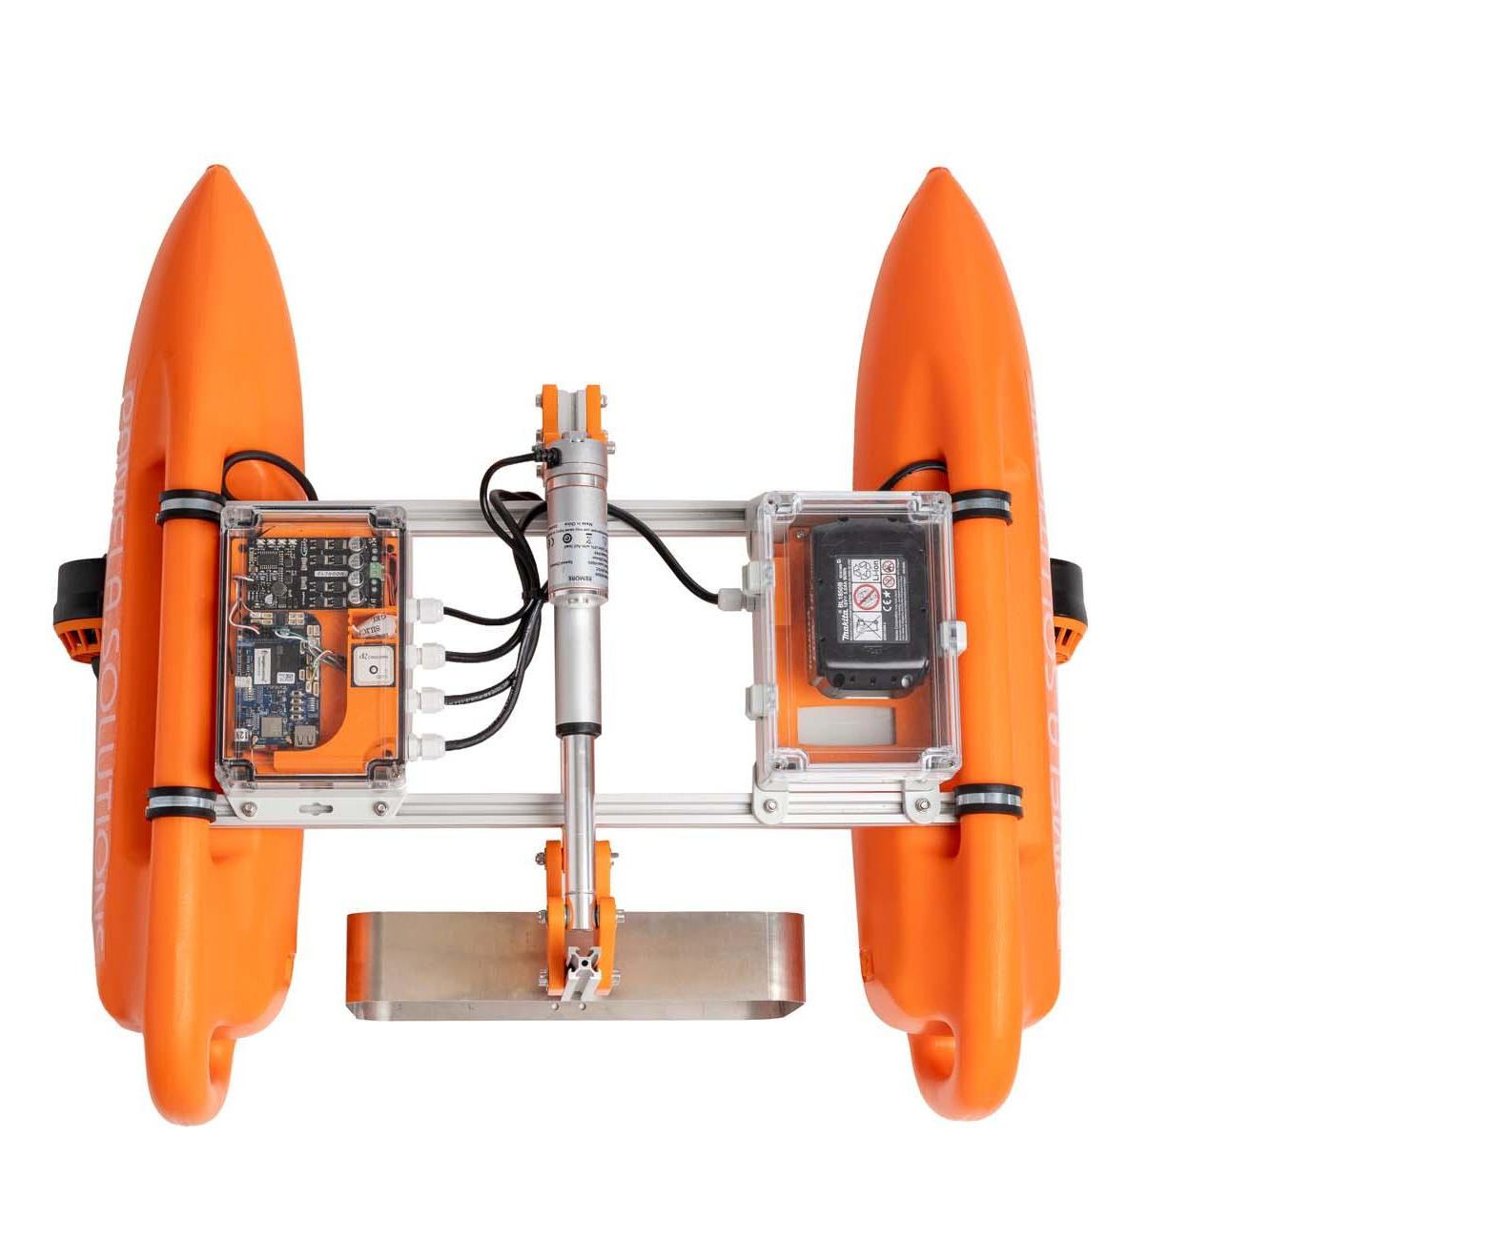
AUTOMATIC
Autopilot with optional actuated inlet
MANUAL
Remotely controlled instruments carrier
81 cm x 70 cm x 40 cm
< 10 kg
--
45-60 min
WiFi, 433/915 MHz, RC, LTE
Satellite tracking, Worldwide Assistance
Autopilot, GNSS, IMU
DIMENSIONS
WEIGHT
PAYLOAD CAPACITY
ENDURANCE
COMMUNICATION
NAVIGATION
81 cm x 70 cm x 40 cm
< 7 kg
8 kg
60 min
RC 2.4 GHz, 233/915 MHz
Manual
Visit: https://pamela.solutions/

Slide 6
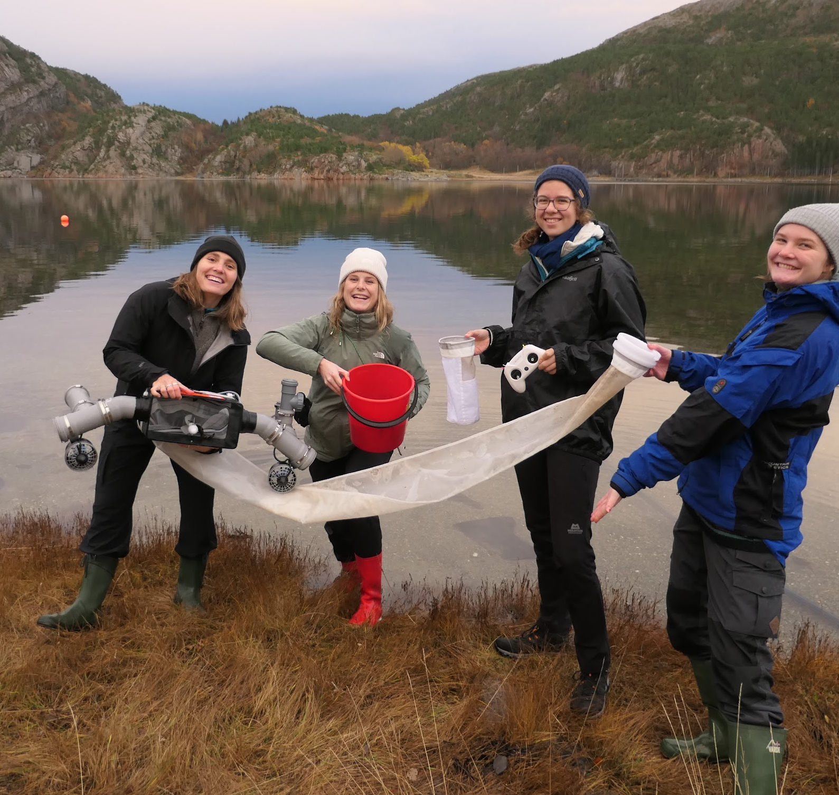
2022
Evolution of PAMELA
led by user feedback
Discovery grant
(200 000 NOK)
field testing and user feedback
early prototype
conception and design
2021
2023

Slide 7
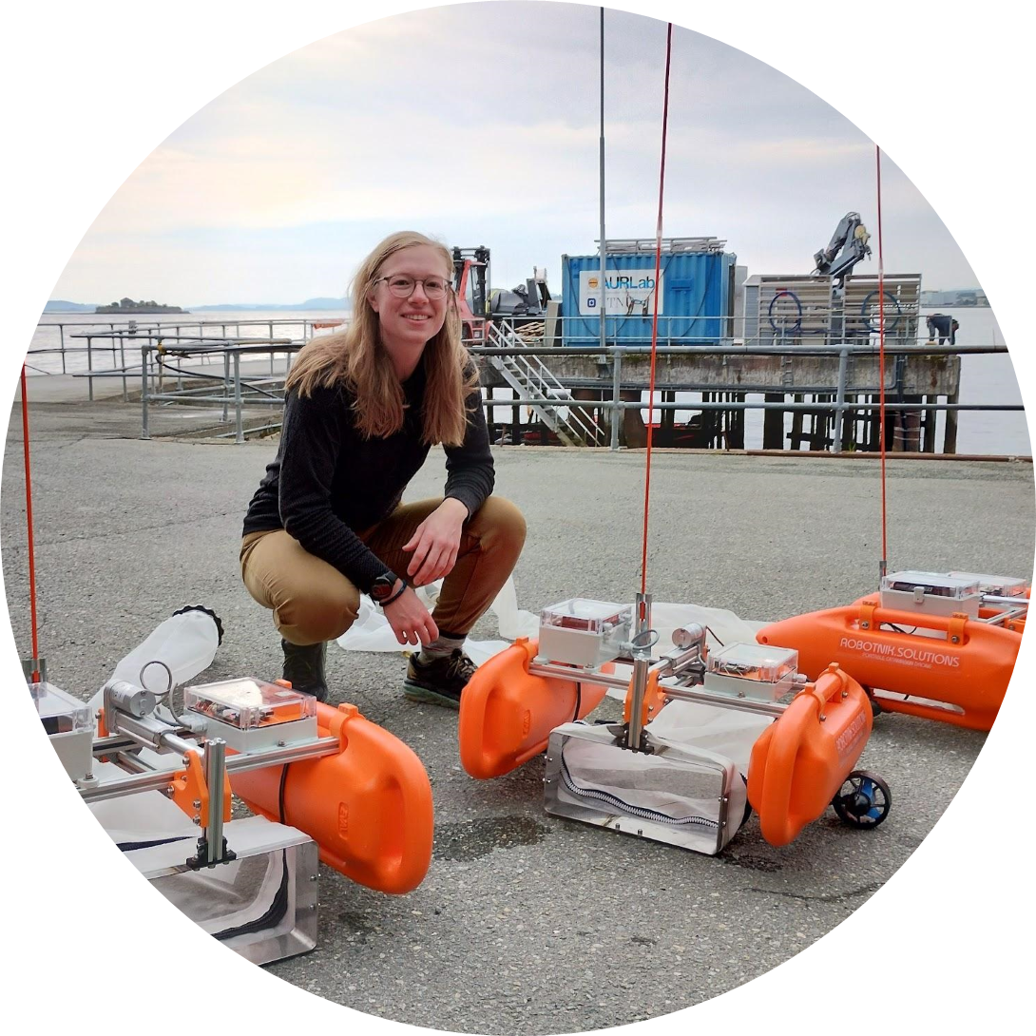
Evolution of PAMELA
led by user feedback
2022
New prototypes (3 units)
field testing in Norway, Ghana, Tanzania
Conferences and media coverage
Extended field campaign in Runde
2021
2023

Slide 8
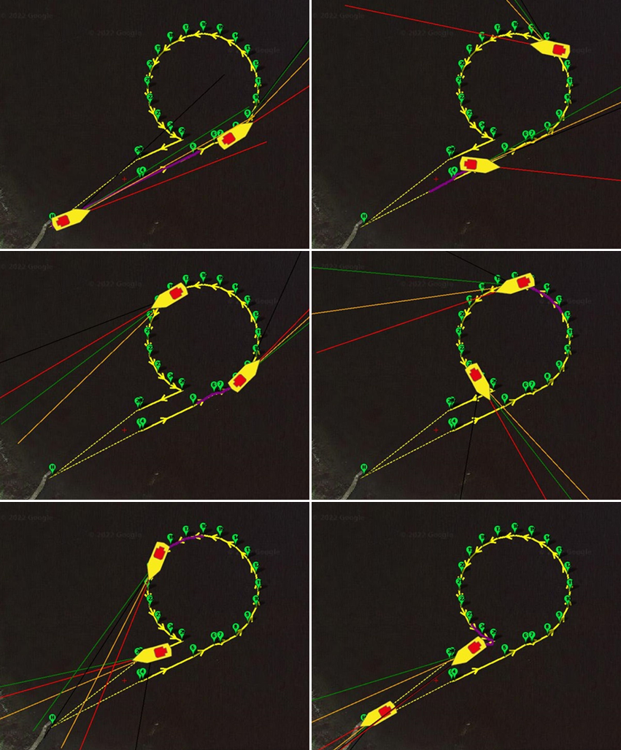
VALUE PROPOSITION
MULTI-ROBOT
2 units = ½ time required
AUTOMATIC
enables multitasking
REPEATABLE
enhances data quality
Visit: https://pamela.solutions/
Notes:
add numbers (concrete numbers on how you save time money etc)

Slide 9
VALUE PROPOSITION
PACKABLE
can be transported internationally in regular checked luggage
PORTABLE
easily carry all necessary equipment
SAFE
safely deploy from shore or a vessel manually
Visit: https://pamela.solutions/

Slide 10
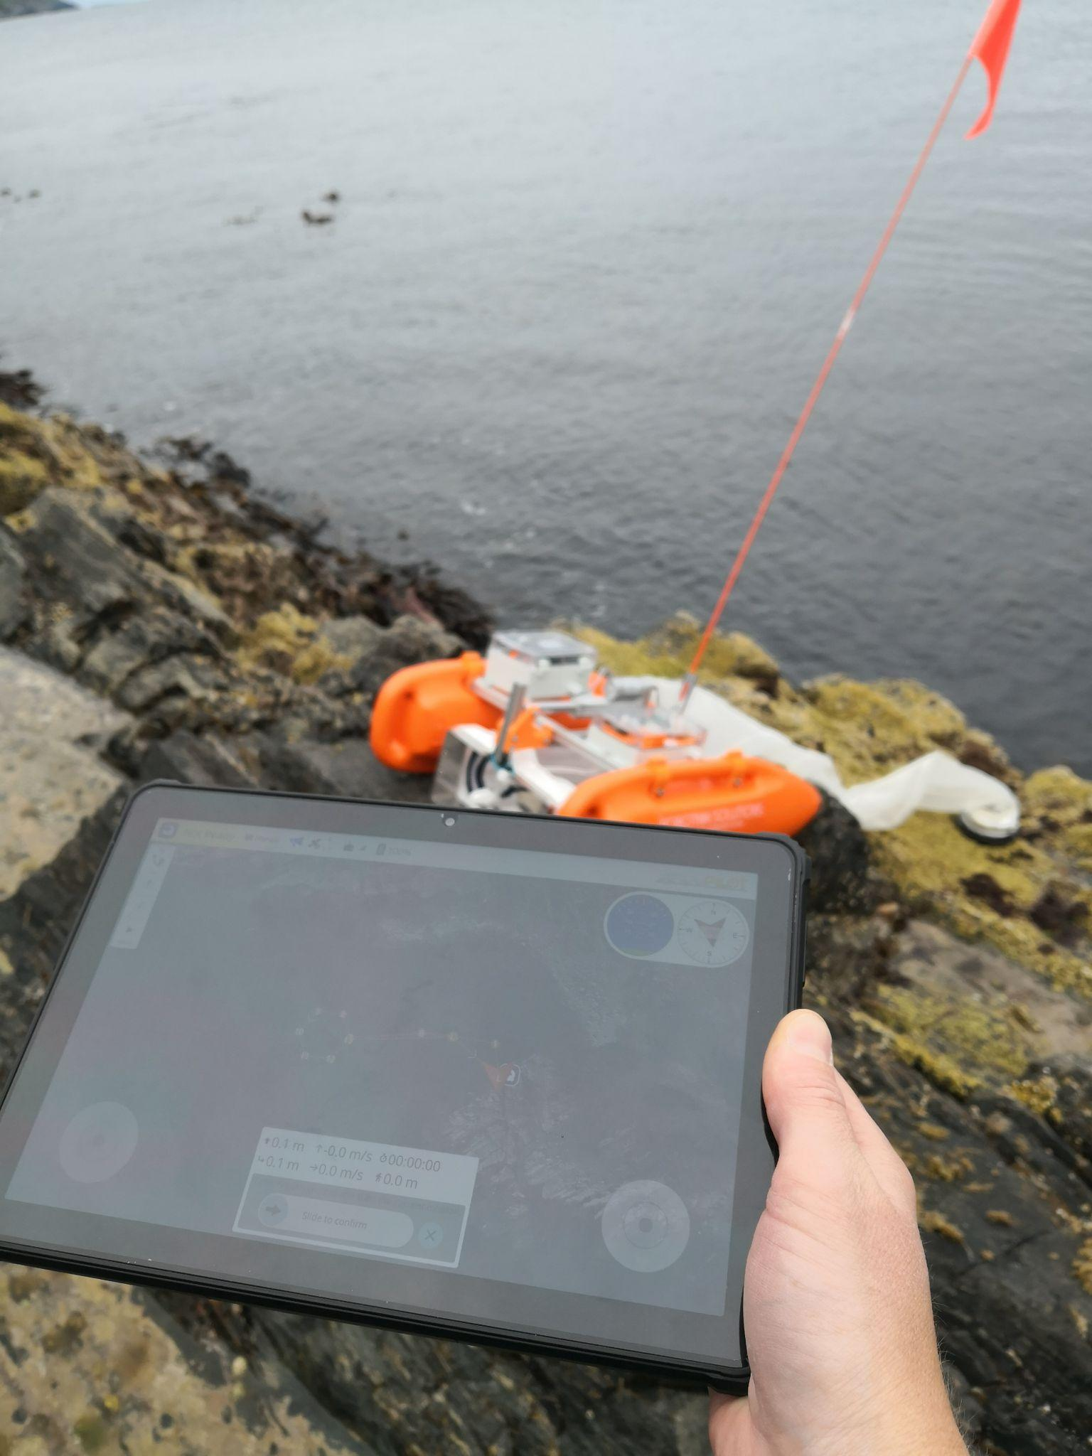
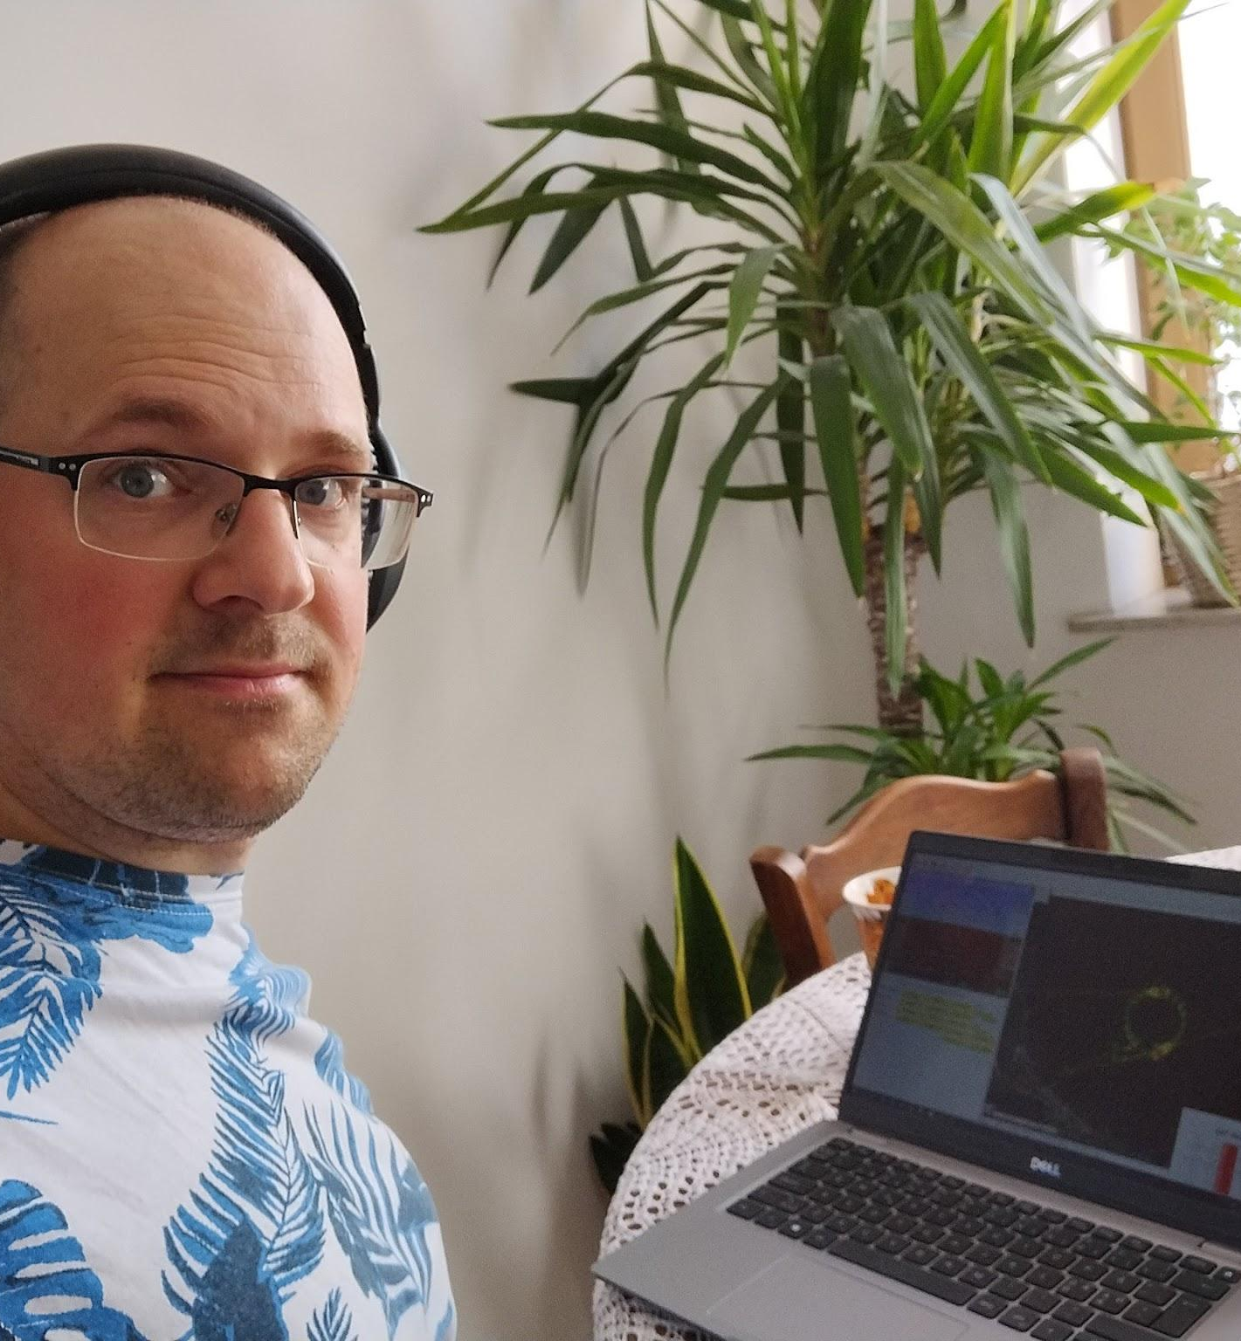
Value proposition: Worldwide Assistance - over LTE, satellite tracking
VALUE PROPOSITION
WORLDWIDE ASSISTANCE
connect remotely through LTE
SECURE RECOVERY
independent satellite tracking
Visit: https://pamela.solutions/

Slide 11
APPLICATIONS
MICROPLASTICS SAMPLING
collection of a surface trawl using a 300 um mesh net
SALMON LICE SAMPLING
collection of a surface trawl using a 120 um mesh net or water volume sampling
SATELLITE CALIBRATION
water leaving reflectance measurements with Ramses sensor payload
WATER QUALITY PARAMETERS
salinity, temperature, fluorescence and turbidity measurements for standard marine surveys

Slide 12
TRACTION
Institution | Role of our POC | Country | Interest | Funnel
The Ocean Cleanup | Head of Environmental & Social Affairs | Netherlands | Manta-net | 5. Interest
CNRS | Researcher at the Functional Ecology and Environment Laboratory (LEFE) | France | Manta-net | 5. Interest
NASA JPL | Post Doc | USA | Radiometer payload | 5. Interest
Columbia University | Lamont Research Professor | USA | Radiometer payload | 5. Interest
NIVA | Chief Scientist | Norway | Manta-net, Radiometer payload | 4. Consideration
Akvaplan niva | Scientist | Norway | Manta-net | 4. Consideration
University of Gothenburg | Professor | Sweden | Manta-net | 5. Interest
ExxonMobil | Environmental Scientist | USA | Manta-net | 6. Awareness
University of Strathclyde | Reader | UK | Radiometer payload | 5. Interest
NTNU | Professor | Norway | Manta-net | 5. Interest
NTNU | Forsker | Norway | Manta-net | 5. Interest
Visit: https://pamela.solutions/

Slide 13
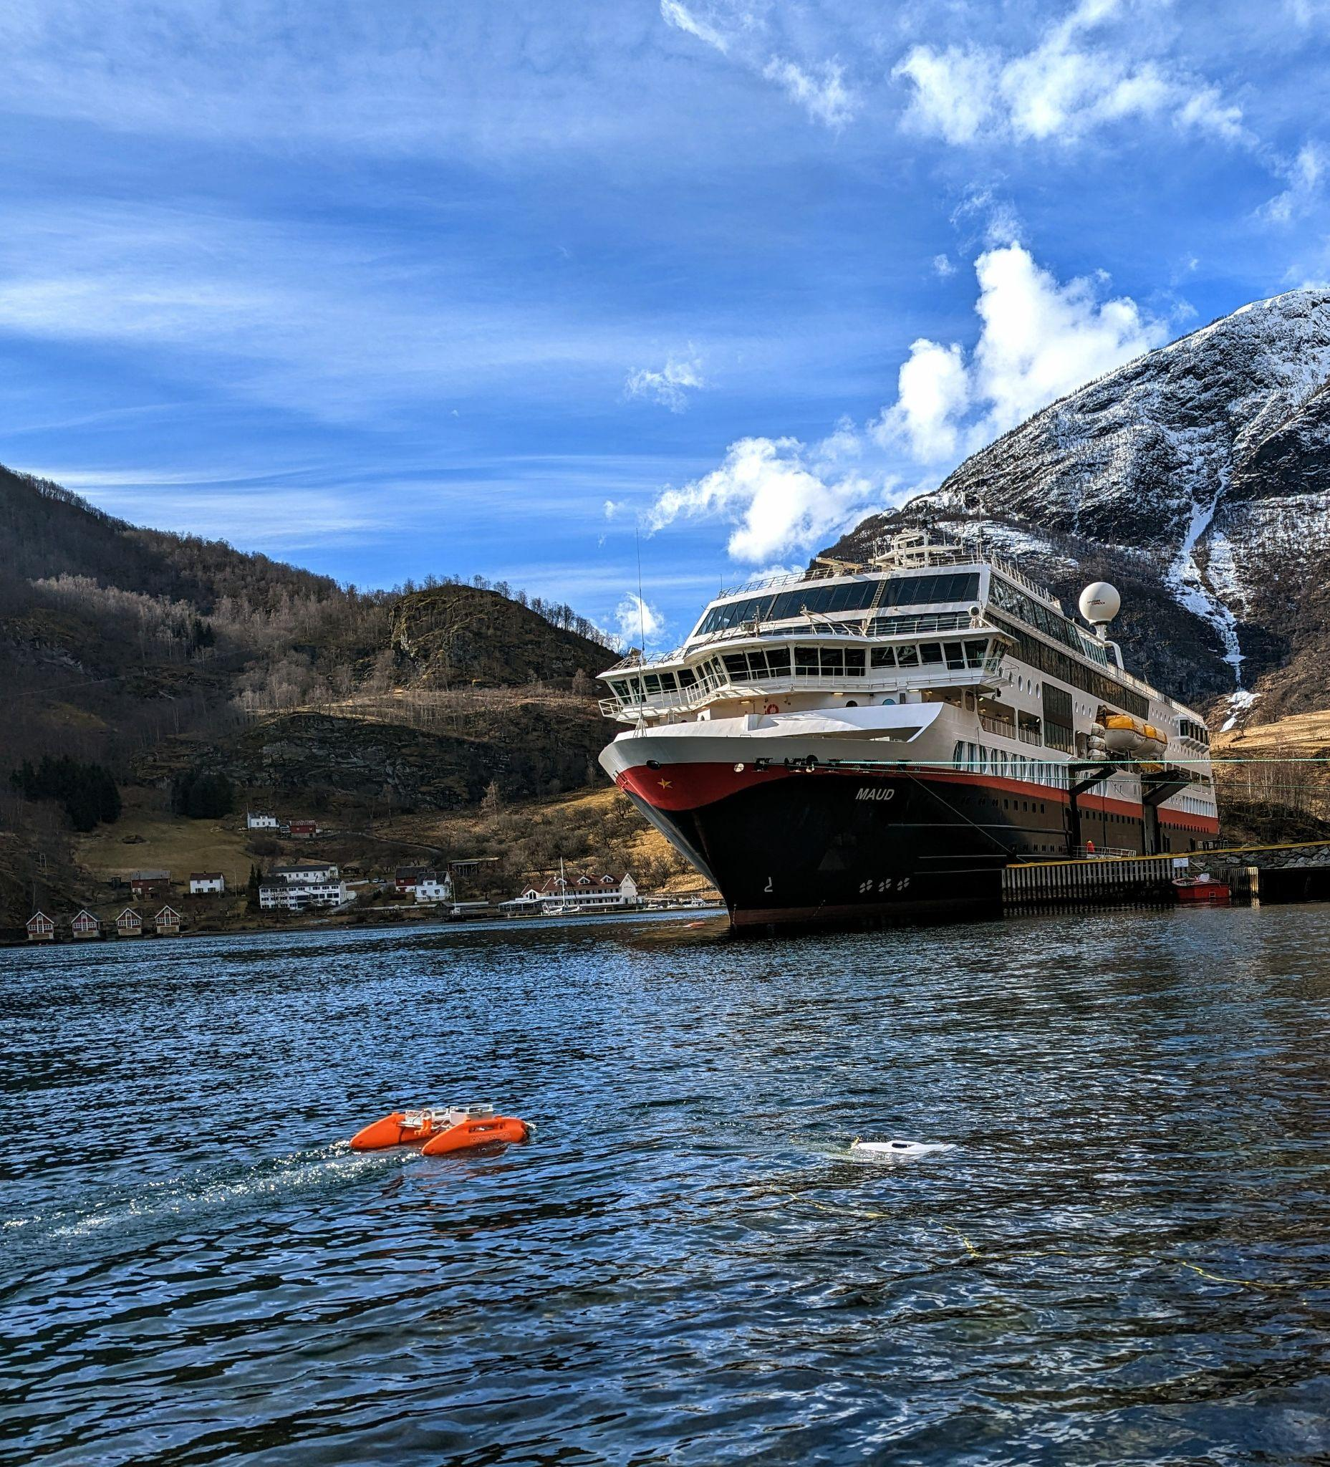
UNDER CONTROL-ISH
Building competence (6am)
Soft funding (somewhat)
Immediate customers
CHALLENGES
From innovation to product
Capital for joining projects (restrictions on soft funding)
Hardware is hard! (NO/INT)
Long term value proposition (analysis?)
“Killer app”
Growing the team
Visit: https://pamela.solutions/

Slide 14
PAMELA
Portable Autonomous Marine
Exploration and Learning Apparatus
Visit: https://pamela.solutions/

