Slide 1
Founder Story Marine Cybernetics AS Lesson learned …..
Professor Asgeir J. Sørensen Department of Marine Technology Norwegian University of Science and Technology, NTNU Mobile: +47 918 97 457 E-mail: Asgeir.Sorensen@ntnu.no web: https://folk.ntnu.no/assor/
Notes:
1

Slide 2
With license to create…
Long term research chasing impact
Researcher driven innovation well tuned with technology trends and market insight
No strings attached regarding IPR
Established a culture for innovation and entrepreneurships
Executive orders from Government, NTNU and partners: Get it done

Slide 3
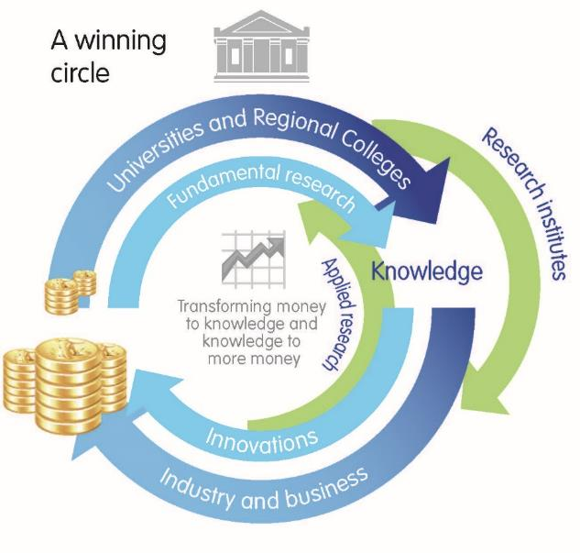
NTNU creates innovations for…
The Norwegian “Silicon Valley” is the blue economy…
Industry partners and collaborators
90%
Universities and research institutes
2%
Governmental agencies
4%
New industry – company spinoffs
4%
New method, product or process that are valuable and taken in use
Ambition: 10x increase in spinoffs

Slide 4
Culture for innovation
Innovation
People
- Pay attention
- Personal attitude
- Culture for innovation
Organization
- Complete research methodology
(theory, simulation, experiments, demonstrations)
- Infrastructure development
- Innovation techniques and methods
Acceptance
- Use of time
- Publications
- Buy in from NTNU
- Mobilizations of partners
Funds and Resources
- NTNU TTO
- Seed-funds, investor groups
- Industry partners
- Public funding (IN, RCN)
Method developed by NTNU AMOS in collaboration with NTNU TTO

Slide 5
Notes:
Transfer the research results and ideas into products or services that will benefit society

Slide 6
NTNU Research Centre of Excellence Spin-offs (CeSOS, NTNU AMOS)

Slide 7
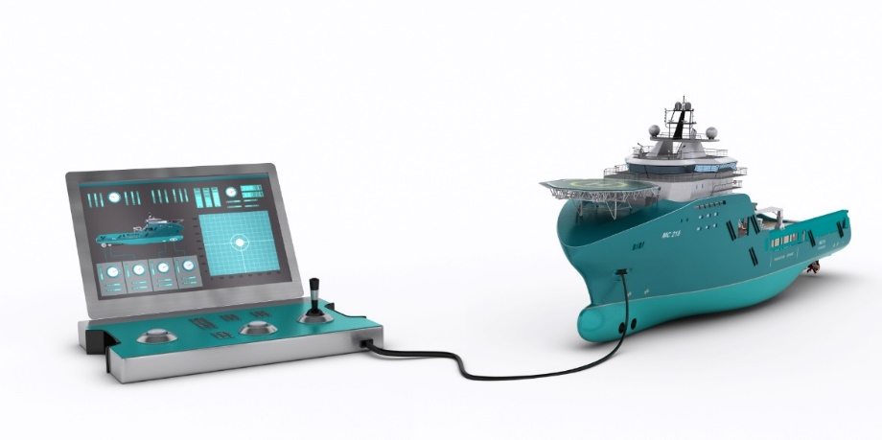
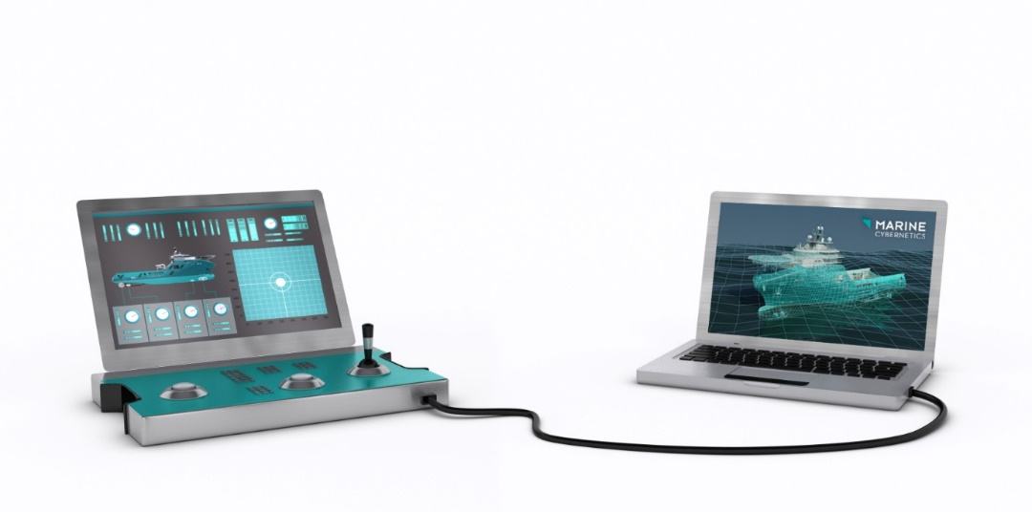
Etablert i 2002
Solgt til DNV GL 2014
Testing of control systems through use of simulators

Slide 8
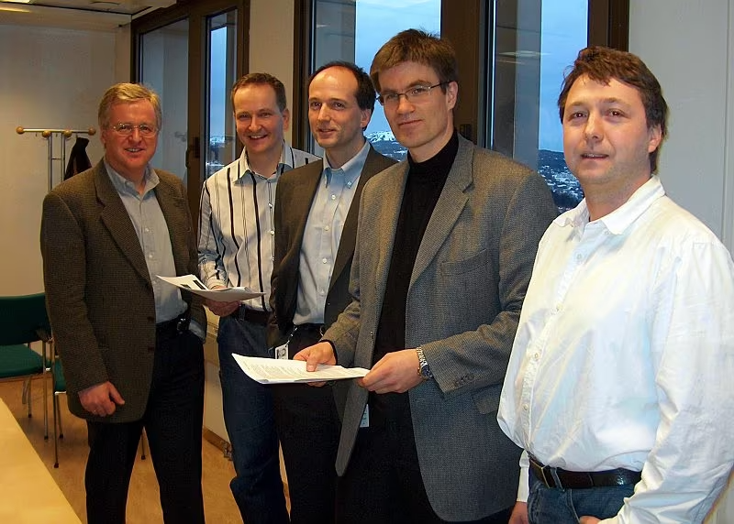
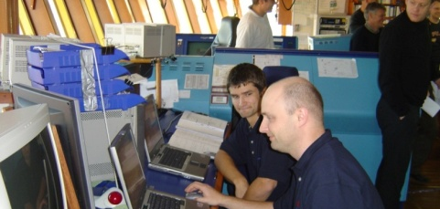
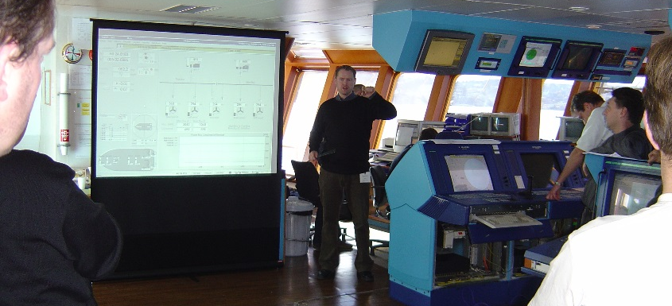
Notes:
-In addition to being a genius, Asgeir had also been building up a strong team of people, having the ability to hand-pick the best candidates from NTNU.
-This is important, because without a strong team you will not be able to succeed. A with that team we embarked on a new journey.

Slide 9
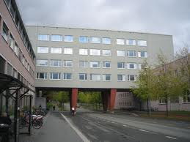
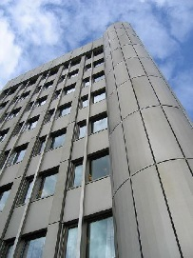
Headcount, revenue and expansion
July 2010 / April 2011: Houston
office opened / US legal entity established
TTO very important
Exit
10—20 years
External investors rules the game:
Venture – Business Angels – Private Equity - Industry
January 2011 / May 2011: Rio de Janeiro office opened / Brazil legal entity established
Statoil LUP
Third share issue: Jebsen Asset Management
IFU contract with Statoil R&D
IFU contract with Statoil and DNV
First share issue: Statoil Innovation
NFR Petromaks project with Maersk
Focused IFU with industry partners
Second share issue: Statoil Innovation

Slide 10
The four critical focus areas in technology spin-offs
Market
Technology
Finance
Organization
If you fail in any of these, you are out-of-business

Slide 11
Increasing challenges
R&D
Running business
Expansion
Wrong:
Difficult Easy Easy
Correct:
”Easy” Difficult Difficult
Growth is driven by the cash position secured by investors and sales

Slide 12
The customers behave differently adapting new technology driven by cost, risk, profit, volume vs. niche, ……
Front runners
Early
Late
Never
The market takes off when you have captured both the Front runners
and the Early out customers

Slide 13
Effort to commercialize R&D pilots to products/services generating positive cash flow is both time and cost consuming …
Product/Service $
R&D and sales cost
We tend to stop here
Time to Market
Prototype!
Time
Complete the work
Commercialization is the hardest part in innovation
Money and time (R&D, sales, operations) to go from research pilots including licensing agreements to cash-cow products are almost always overlooked and underestimated
It generally takes 5-7 years to succeed with new products/services in industrial markets even for established companies

Slide 14
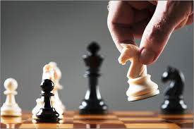
Success factors
Comparative advantages
Unique selling proposition
Change the rules of the game
Access to capital and competence
Speed in implementation
Endurance
Teamwork
Winner instincts
Being professional from day 1

Slide 15
Increase ambitions: We should move comma in terms of spin-offs from uiniversities
Challenge NTNU, ++ and the surrounding innovation ecosystem in scaling up capabilities and capacity in terms of financial and human capital
Pessimists never win wars!

Slide 16
Etablering av Marine Cybernetics
Suksesskriterier | Tilrettleggeren
Unik forretningsidé Topp fagkompetanse kombinert med god forretningsforståelse og nettverk Likeverdig fokus på teknologi og marked Komplementært gründerteam Pågangsmot og utholdenhet hos gründerne Erfaring fra både industri og NTNU | Gründerteamet: 4 professorer 1 forretningskonsulent 1 advokat
Kompetanse-basert innovasjon Systematisk og langsiktig forskning ved NTNU innen teknisk kybernetikk og marin teknikk Støtte og tilrettelegging fra Institutt for marin teknikk, Institutt for teknisk kybernetikk og CeSOS ved NTNU Norge har en verdensledende klynge innen maritime, olje og gass med tradisjoner for innovasjon Innovasjon i kjølvannet av industrilokomotiver som Statoil, DNV, … Ekstern- og intern rekruttering av rett ledelse og mannskap til rett tid og rett plass(styret, CEO, CTO, CMO, COO, osv) | NTNU Norges Forskningsråd Innovasjon Norge Industrien Ansatte Selskapsledelsen Styret Eiere

Slide 17
Kommersialisering og vekst
Suksesskriterier | Tilrettleggeren
Inkubatorfasen: Teknologiutvikling (Forskning og Utvikling) Forretningsutvikling Referansesalg (pilot 1) | IG NTNU Innovasjon Norge Statoil LUP, DNV Skattefunn
Kommersialiseringsfasen: Teknologiutvikling (Forskning og Utvikling) Forretningsutvikling Organisasjonsbygging Referansesalg (piloter 2, 3, 4….) | Innovasjon Norge Statoil I&K Skattefunn DNV
Vekstfasen: Teknologiutvikling (Forskning og Utvikling) Trimming av produktene/tjenestene Masseproduksjon Organisasjonsbygging Internasjonal etableringer Partnerskap/agenter Eksternt rekruttert CEO med ballast for lønnsom vekst Oppkjøp (exit) | DNV Innovasjon Norge Norges forskningsråd Statoil I&K Jebsen Asset Management ….nye investorer eller kjøpere …

